Slide 1
Advanced Algorithms Assignment
Group 22: 1. Duong Gia An - 2470293
2. Trinh Son Lam - 2470287
3. Nguyen Thi Thu An - 2470315
4. Nguyen Thanh Nhan - 2012522
5. Vuong Minh Toan - 2491057
6. Pham Le Trong Bang - 2110811

Slide 2
Member Contribution
Name | Contribution | Percentage
Duong Gia An | Team Lead | 17.5%
Trinh Son Lam | Idea - Implement - Slide | 17.5%
Nguyen Thi Thu An | Idea - Implement- Slide | 17.5%
Nguyen Thanh Nhan | Idea - Implement - Slide | 17.5%
Pham Toan Vuong | Idea - Implement - Slide | 17.5%
Pham Le Trong Bang | Idea | 12.5%

Slide 3
Timeline (week)
Implement
Check error
Choose algorithm and coding
List error test case
01
02
03
04
05
Idea
Improvement
Finalize
Define problem and solution
Accuracy in processing
Average Time run

Slide 4
Table of contents
01
02
03
Problem
Pseudocode
Build trie
04
05
06
Preprocess n-gram
Matching stretary
Result

Slide 5
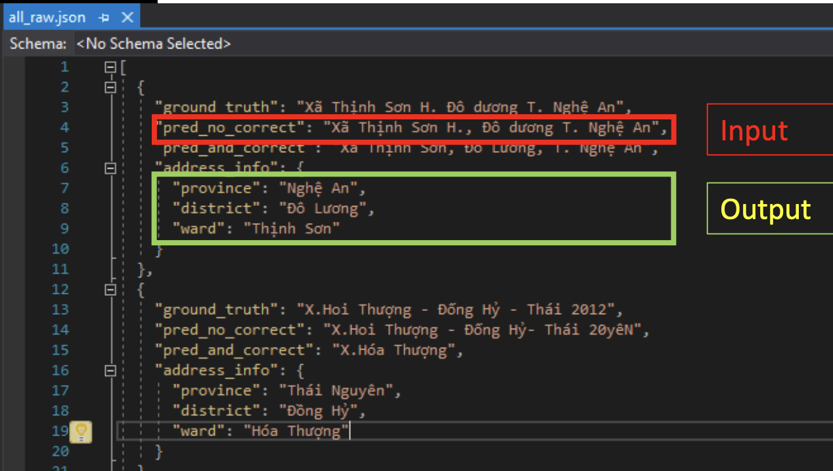
Problem
Define problem: Extract province, district, ward from given address text
Requirement:
Estimated time for each address below ….
Average time for 1 request: ≤4/100 s
Do not apply a machine learning approach, just algorithms.

Slide 6
Problem Analysis
Description | Example
Address contains ward, district, province in order without spelling errors and optional prefix | TT Tân Bình Huyện Yên Sơn, Tuyên Quang Thanh Long, Yên Mỹ Hưng Yên
Address contains (w,d,p) in order with spelling errors in either location names or location prefix | Tân Hòa,H. Phú Tân,TnhAn Giang
Address contains components other than ward, district, province. | 357/28,Ng-T- Thuật,P1,Q3,TP.HồChíMinh. 284DBis Ng Văn Giáo, P3, Mỹ Tho, T.Giang.
Address misses components in ward, district, province | XDuy Hải TQuảng Nam ,H.Tuy An,Tinh Phú yên
Address contains abbreviations | F2B PhanVănTr P.5,GV,TP.Hồ Chí Minh F.LoWng Binh, TpThủ Đưc, TPHCM

Slide 7
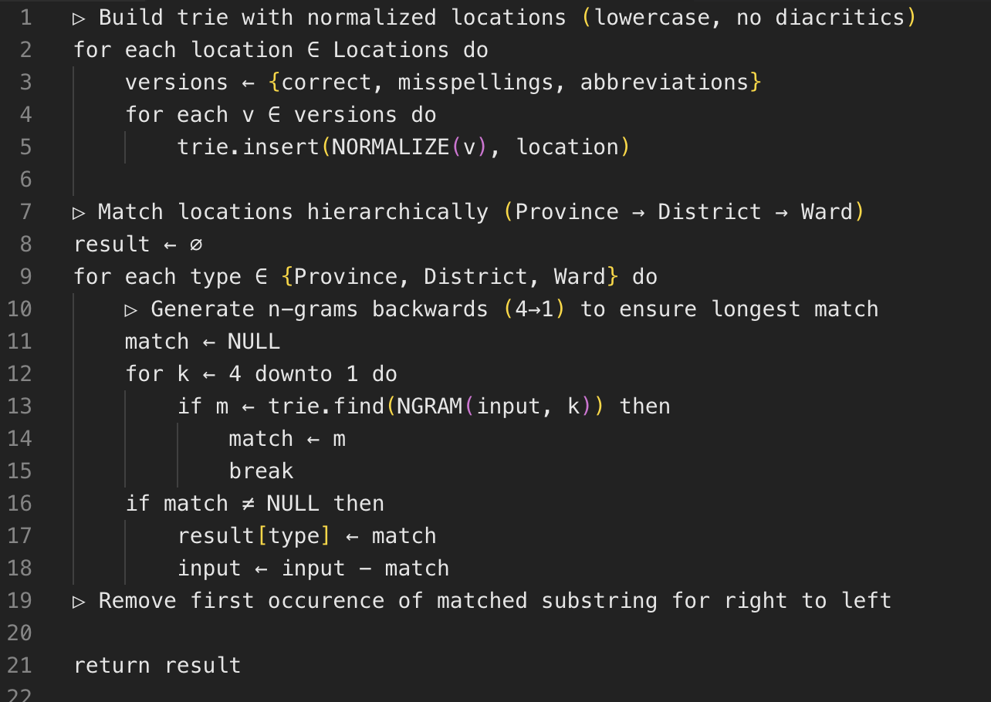
Pseudocode

Slide 8
Build Trie
For each location (ward, district, province), build 3 trie
Correct spelling trie: contains location prefix + normalized string of location. Numeric location such as ward 1, 2,.. must be combined with a prefix. Location prefix contains:
Full prefix: Huyen, ThanhPho,..
First letter abbreviation: H, TP, X, TT,..
First letter last word abbreviation: Tpho, Txa, Ttran,..

Slide 9
Build Trie
For each location (ward, district, province), build 3 trie
Incorrect spelling trie: From correct spelling trie, create incorrect version of each location. Given an alphabet set as ALPHABET = 'abcdefghijklmnopqrstuvwxyz0123456789'
Substitute: Each char in location word could be replace with different char in ALPHABET Eg: len(word) = n => 35*n variations
Deletion: Delete each char in location Eg: len(word) = n -> n variations
Addition: Add char in ALPHABET to every index of location word Eg: len(word) = n -> (n+1) * 36 variations
Only allow for incorrect spelling if len(word) >2 and < 20

Slide 10
Build Trie
For each location (ward, district, province), build 3 trie
Abbreviation trie: Allow for abbreviations in both name and prefix
First char abbreviation: HCM, HN,..
First char last word abbreviation: HCMinh, HNoi, …

Slide 11
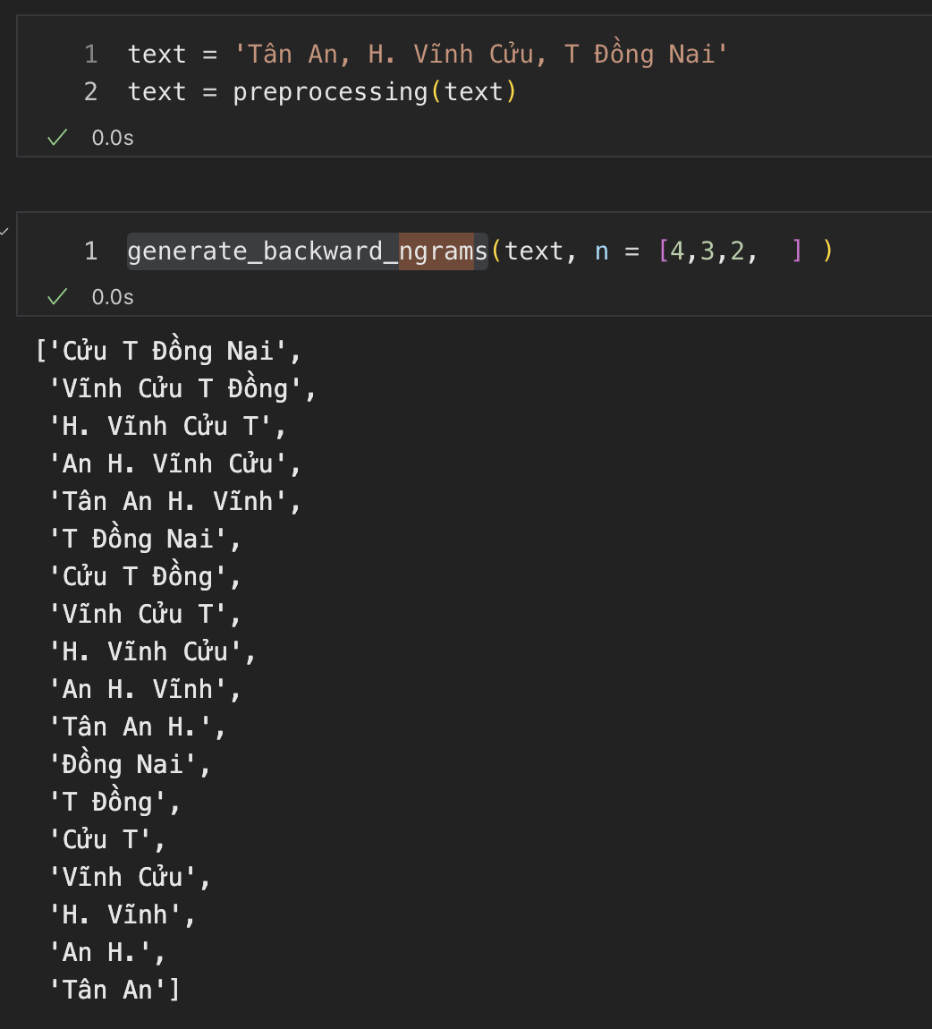
n-gram
Based on database, the longest location word is 4-word long -> maximum of 4-gram
Longest matched substring will be found first.

Slide 12
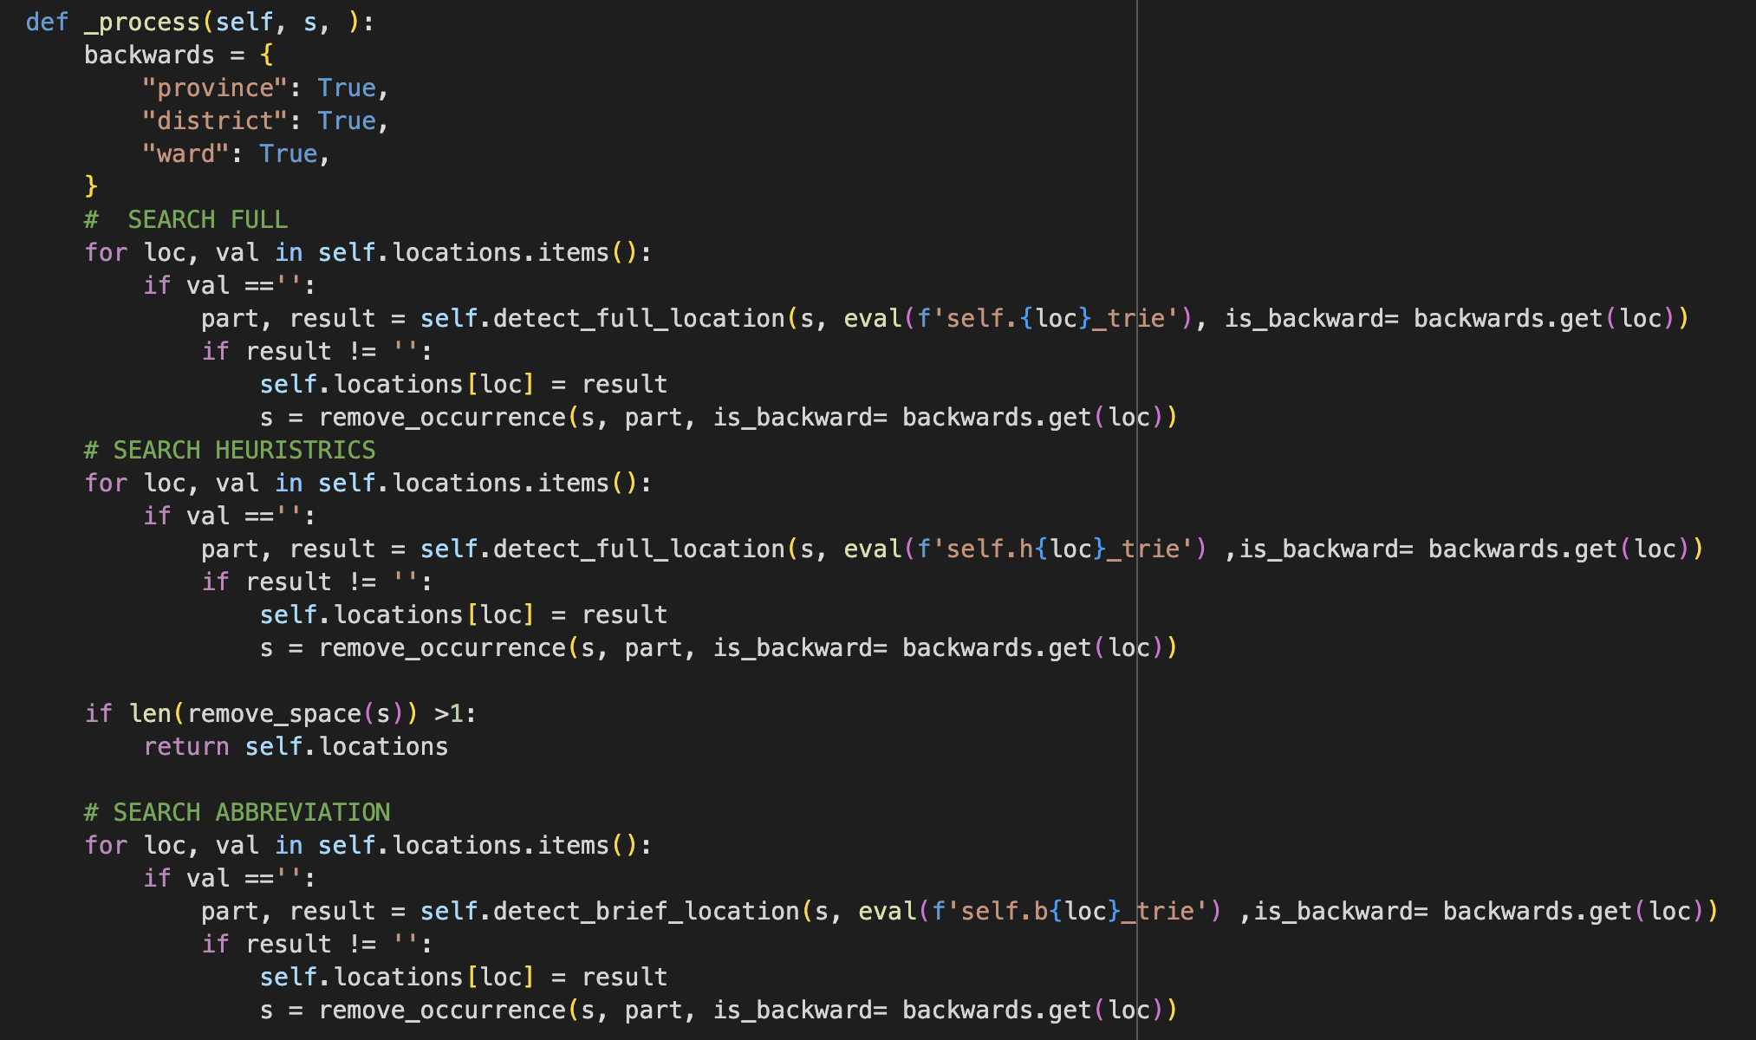
Matching strategy

Slide 13
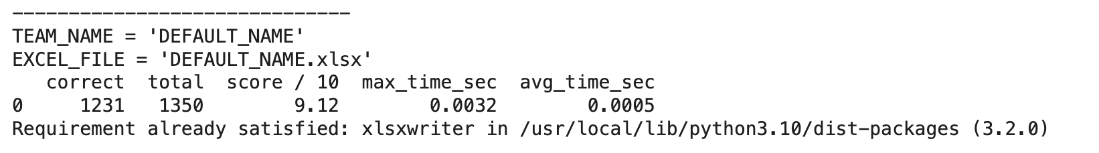
Result
Limitations:
Cannot find location with >1 character spelling error
Cannot distinguish location with single char different Eg: XãV Ninh, Kiên Xương, -> Vũ Ninh vs Võ Ninh
Cannot distinguish words with different diatrics Eg: Thạnh Hóa vs Thanh Hóa

Slide 14
Thank you for listening!

